Slide 1
Testsigma
Capabilities

Slide 2
Test Capabilities
Scriptless testing tools reduce or eliminate the amount of scripting involved in the creation of automated tests.
Participation of Business Analyst and Subject Matter Experts
Large test suites can be automated faster
Testsigma is a Scriptless testing tool
Create Automated Tests using plain English
Group tests into Test Suites
Integrate with popular CI/CD tools including Azure DevOps
Watch a video of test execution
Configure on which OS and browsers will test execute (Cross Browser Testing)

Slide 3
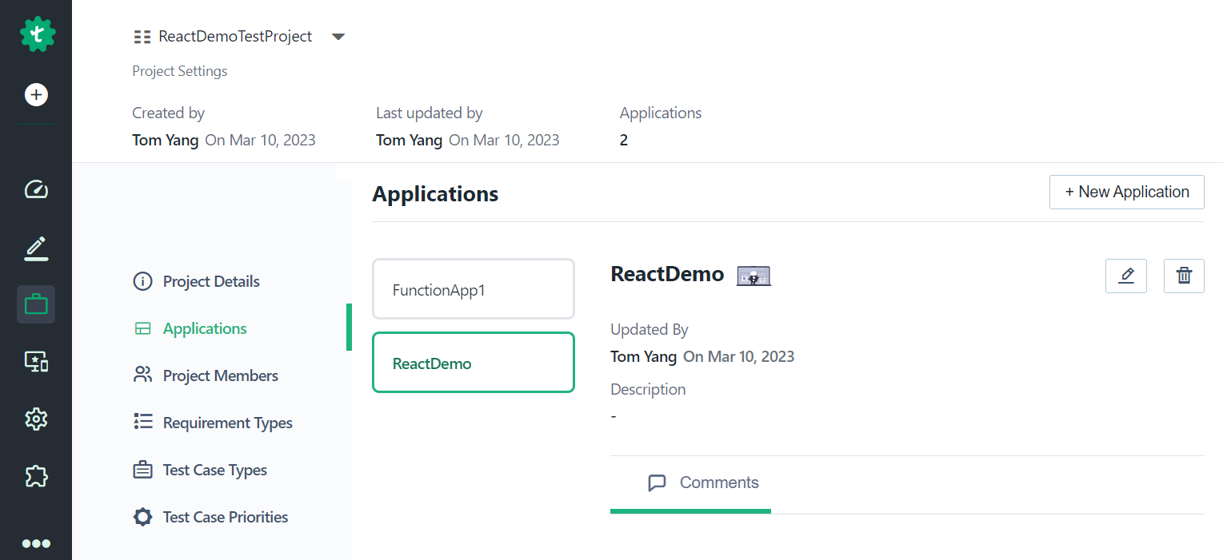
Projects and Applications
Each project can have many applications and there are many types of applications
Web Application
REST API
Mobile Application

Slide 4
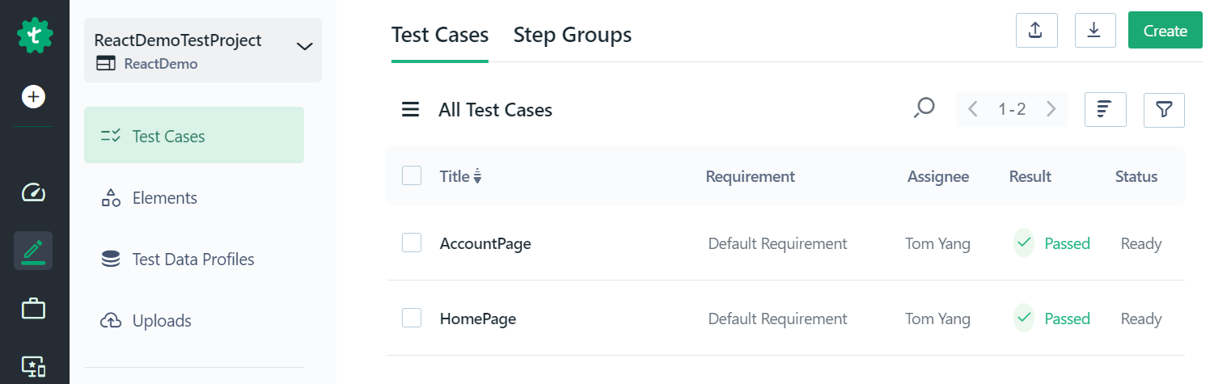
Test Cases
Each application can have many test cases
AccountPage
HomePage

Slide 5
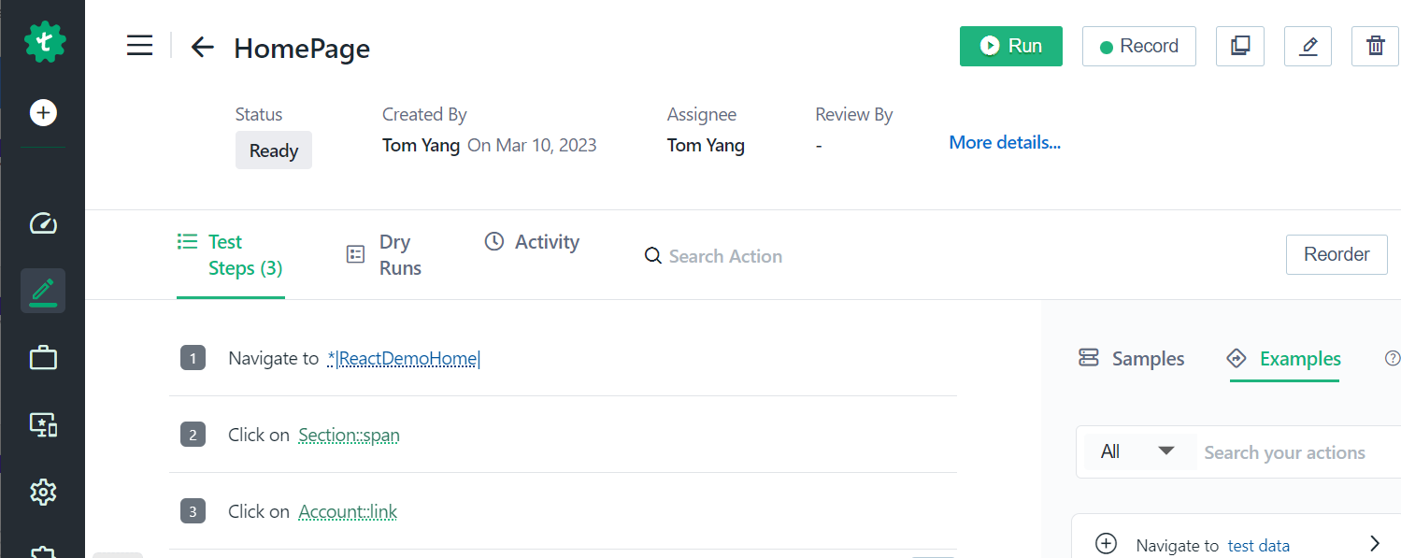
Home Page Test Case

Slide 6
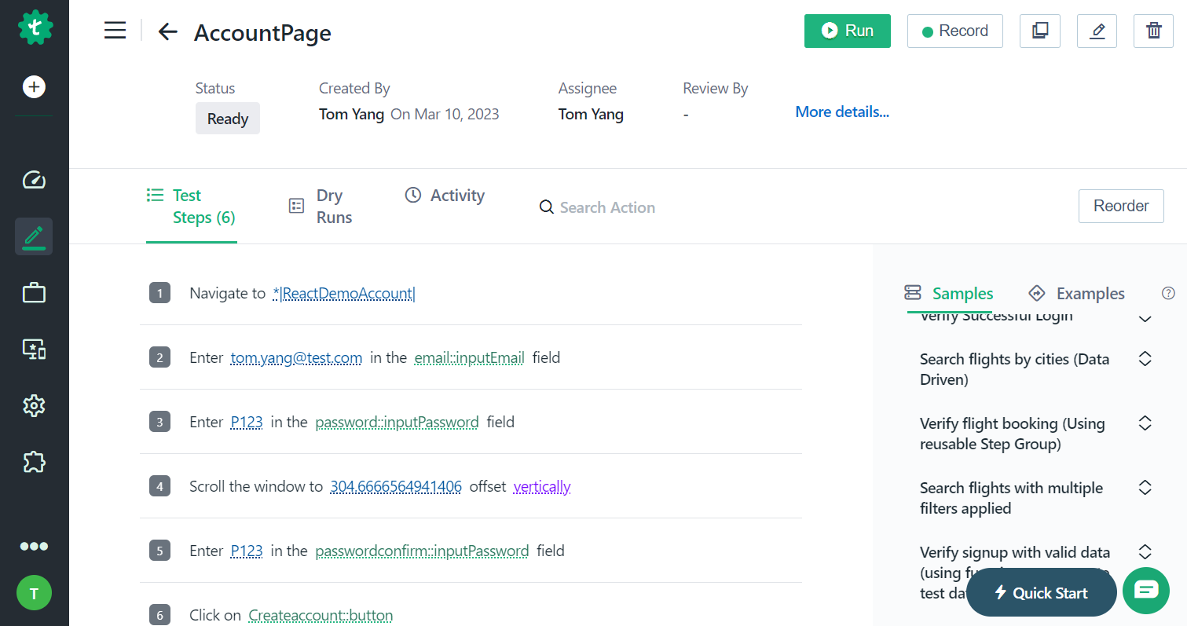
Account Page Test Case

Slide 7
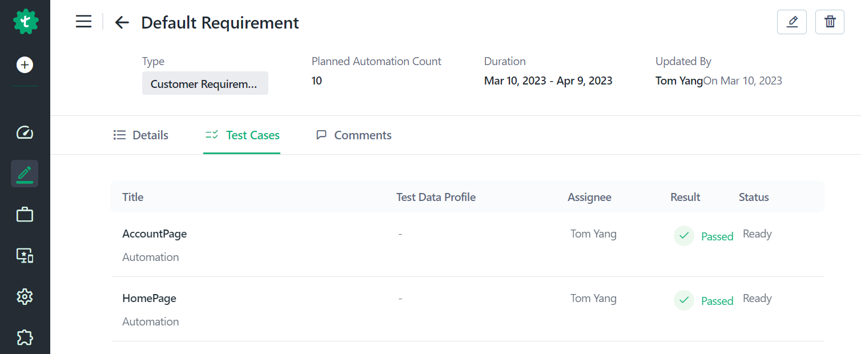
Group Test Cases By Requirement
Organize your test cases based on Requirements
There are many 'requirement types'
Customer Requirements:
User Interface Requirements
Functional Requirements
Non-Functional Requirements

Slide 8
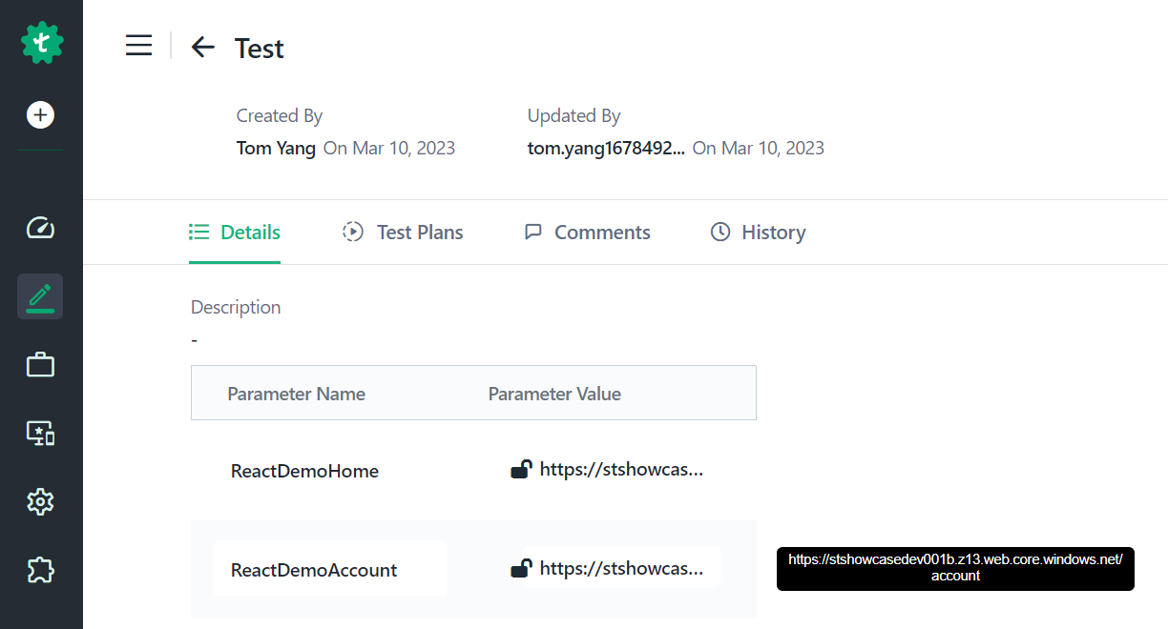
Environment-based Test Data
Ensure that the application behaves correctly in different environments, such as development, testing, staging, and production
Environment-based test data refers to data that is specific to the environment in which the application is being tested.
server names
port numbers
database credential

Slide 9
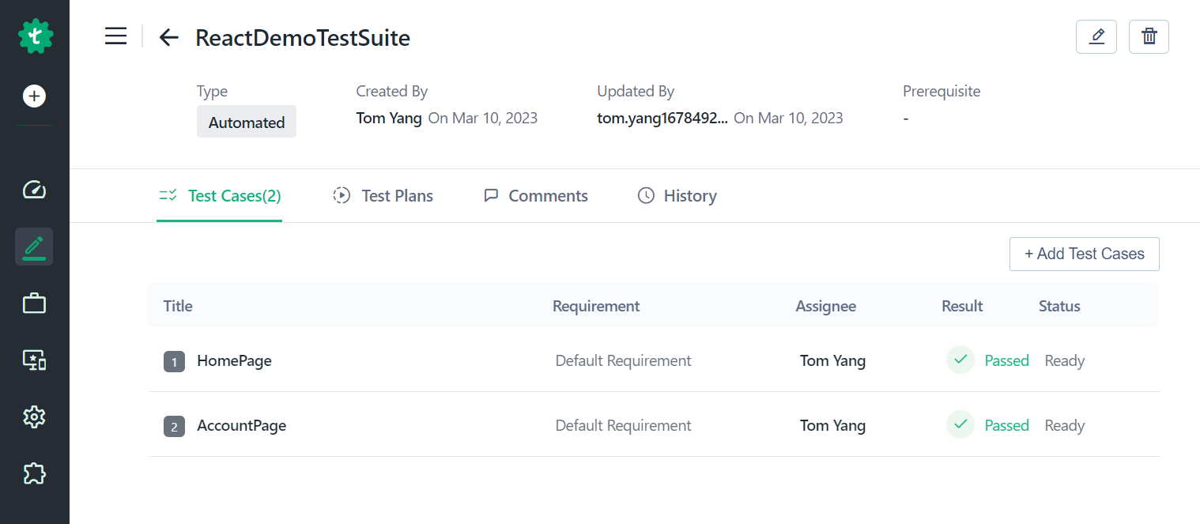
Test Suite
The Test Suite is a set of Test Cases

Slide 10
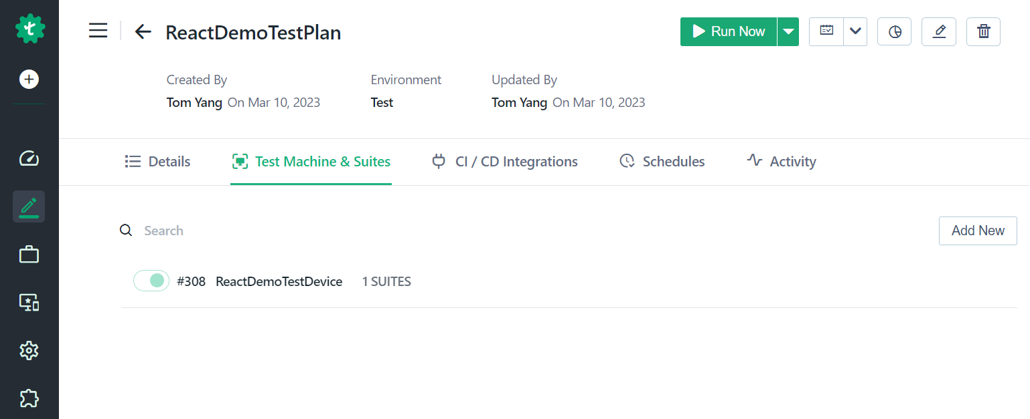
Test Plan
Test plan details and identifies test items, the features to be tested, the testing tasks, the test environment, the test design techniques and so on

Slide 11
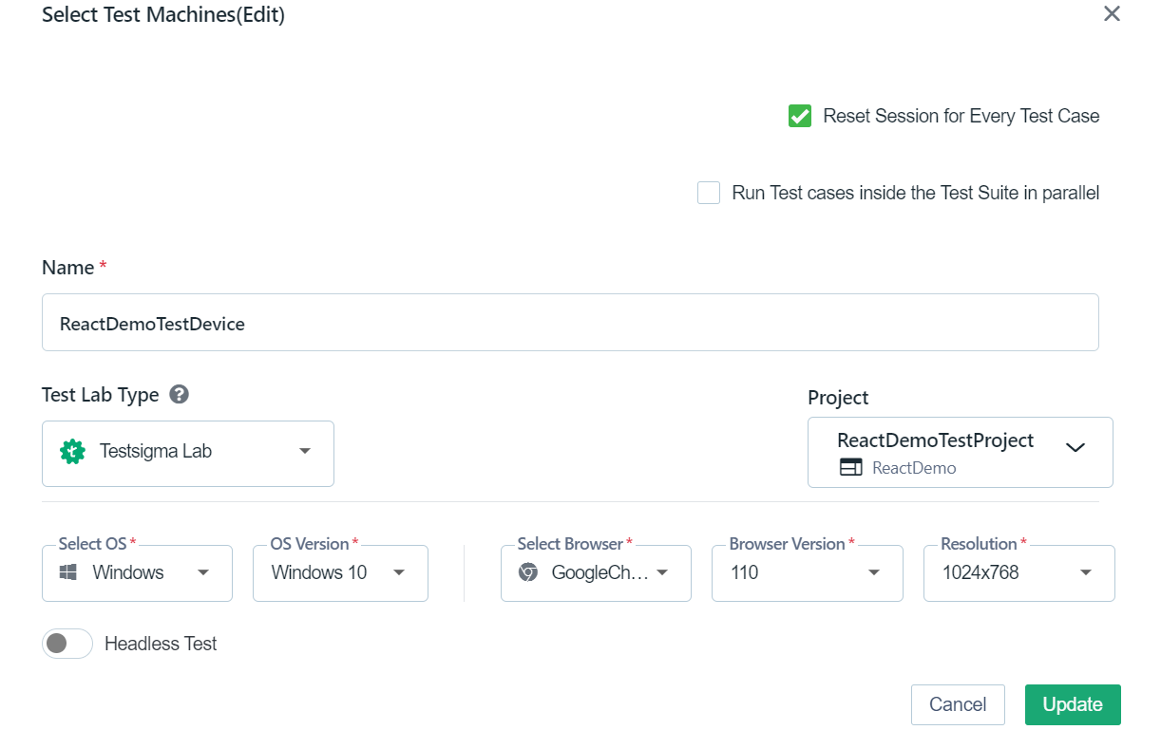
Test Plan - Cont

Slide 12
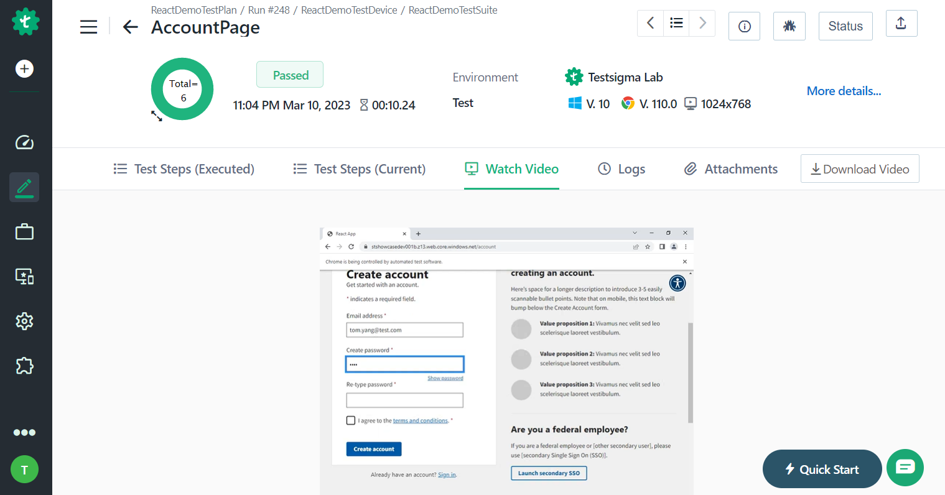
Test Result

Slide 13
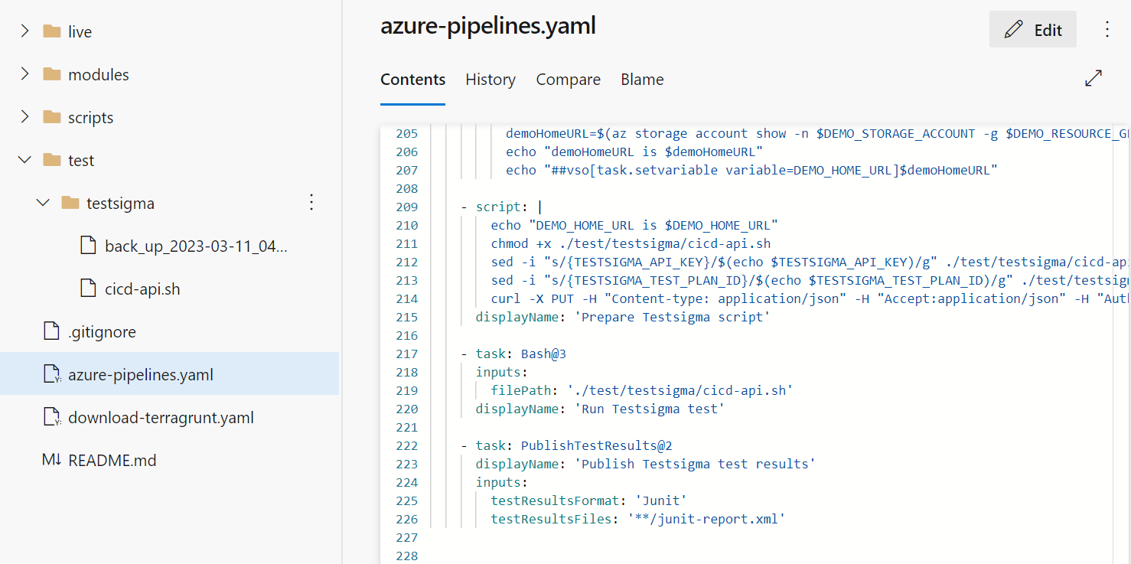
Test Integration with Azure DevOps

Slide 14
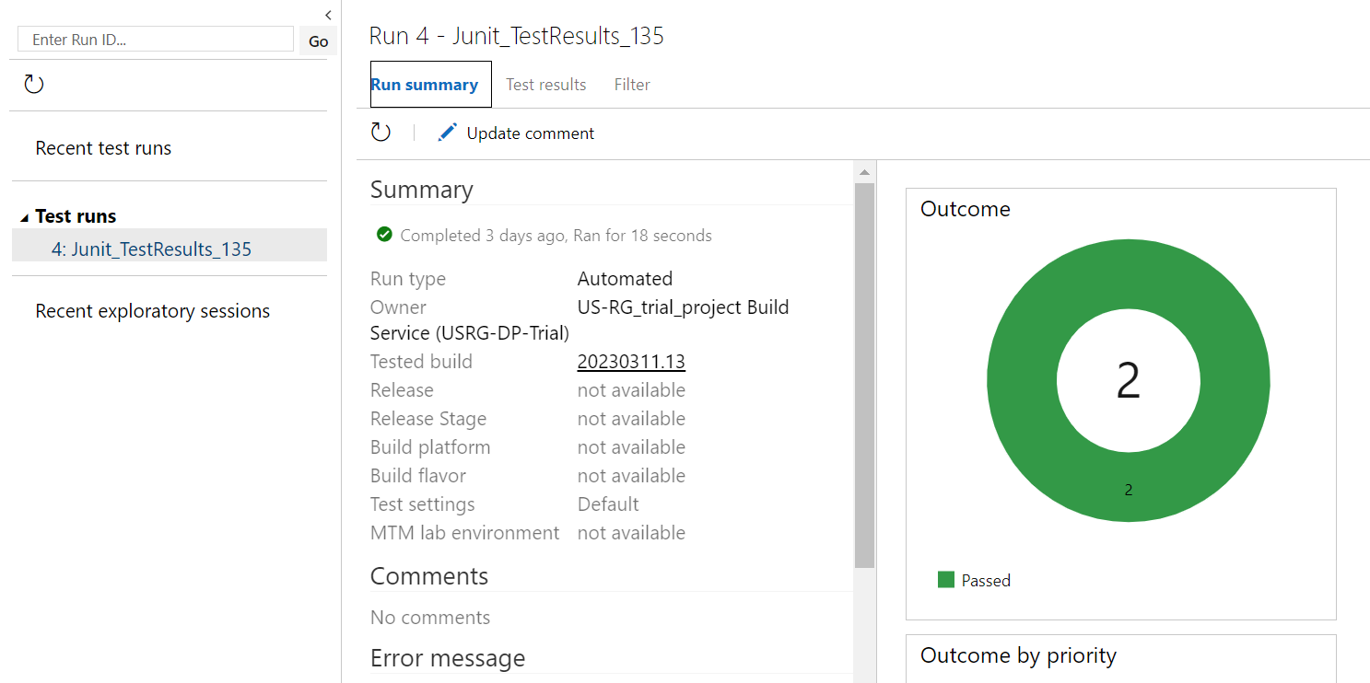
Test Result in Azure DevOps

